Slide 1

WELCOME to my
Presentation on :
QUIC Internet Protocol
Presented by :
Shakib Hossain
IT22011
Department of Information and Communication Technology,
MBSTU
Instructed by :
Dr. Nazrul Islam
Associate Professor,
Department of Information and Communication Technology,
MBSTU

Slide 2
Table of indexes :
1.Introduction to QUIC
2.Purpose of QUIC
3.Technical overview
4.TCP Handshake
5.TLS Handshake
6.How QUIC works
7.Limitations of older protocols that solved by QUIC
8.Features and Advantages of QUIC
9.QUIC application
10.Limitaions and challenges

Slide 3
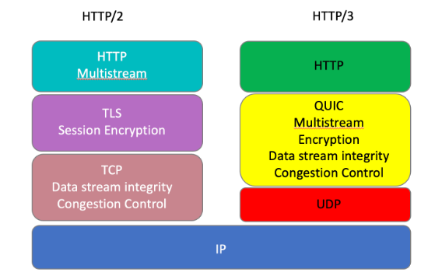
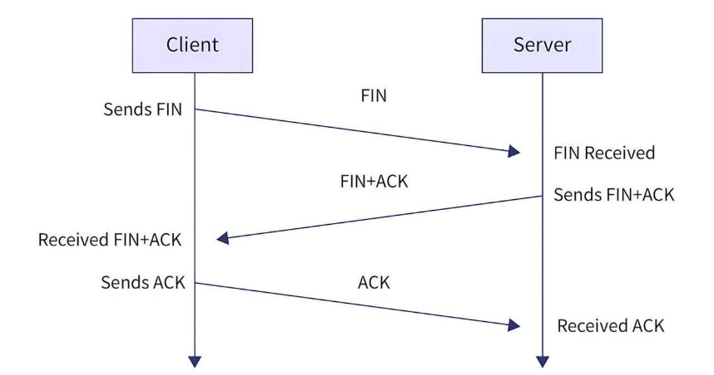
Introduction to QUIC :
QUIC (Quick UDP Internet Connections) is a modern transport layer protocol developed by Google, aimed at improving the performance and security of internet connections.
It effectively addresses latency issues and ensures reliable and secure connections through an optimized handshake process.

Slide 4
Purpose of QUIC:
The main purpose of QUIC (Quick UDP Internet Connections) is to make Internet communication faster, more reliable, and more secure.
Making transmission more reliable.
Improving performance.
Enhancing transmission speed and reduce latency.
Providing string encryption for security.

Slide 5
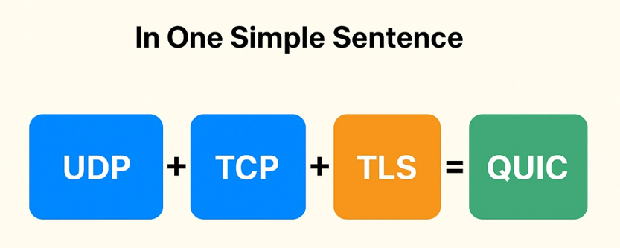
Technical Overview :
Actually QUIC is a updated UDP protocol system that overcomes the issues in old protocols like reliability, speed and security through a optimized handshaking process :
1. Reliability of TCP protocol
2. Speed of UDP
3. Encryption of TLS 1.2

Slide 6
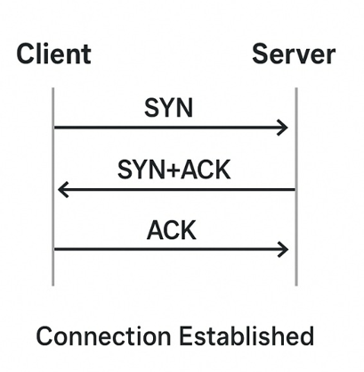
TCP Handshake: (1 RTT)
TCP or Transfer Control Protocol mainly uses HTTP/2 , a 3 way handshake process
to connect with server before data transfer begins.
Step 1: SYN (Synchronize)
Client → Server
Client sends a SYN (synchronize) packet to start a connection.
Client → Server: SYN, Seq = x
I want to start a connection. My sequence number starts at x.
Step 2: SYN + ACK (Synchronize + Acknowledge)
Server → Client
The server receives the SYN.
It replies with its own SYN and an ACK .
Server → Client: SYN + ACK, Seq = y, Ack = x + 1
I received your request (x). My sequence number starts at y.

Slide 7
Step 3: ACK (Acknowledge)
Client → Server
The client sends back an ACK packet to acknowledge the server’s SYN.
Client → Server: ACK, Seq = x + 1, Ack = y + 1
I received your SYN (y). Let’s start communication.

Slide 8
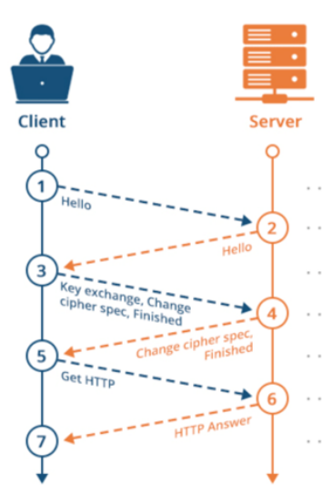
TLS 1.2 Handshake: (2 RTT)
TLS 1.2 use additional 2 round trip for encryption process before transmission starts:
1.Client → Server : “clienthello”
2.Server → Client : “serverhello+certificate”
3.Client → Server : “Key Exchange”
4.Server →Client : “Finished encryption”
NOTE : TCP+TLS/1.2 →(1RTT+2RTT)= 3RTT

Slide 9
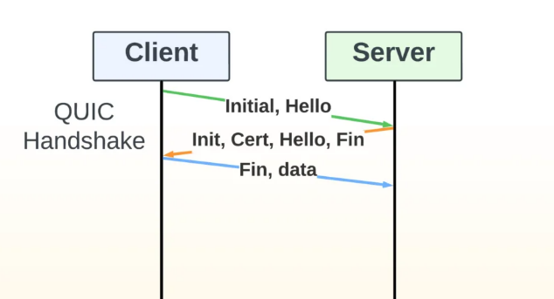
How QUIC works:
QUIC uses its own single handshake that combines connection setup + encryption — based on TLS 1.3 — and it usually completes in 1 RTT. It has its own in-built encryption process(no extra handshake is needed).
Client→Server:
“ClientHello” + key info
2. Server→Client:
“ServerHello”+ “Certificate” + Finished
3. Client→Server:
“Finished”+ Encryption starts immediately
NOTE : In total of 1RTT.

Slide 10
Limitations of older Protocols → Solved by QUIC :
Features | Older Protocols | QUIC Internet Protocol
Connection setup latency | TCP requires a 3 way handshake(1RTT) for establishing connection + Needs another 1 or 2 RTT for TLS encryption. | QUIC combines TCP +TLS handshake in a single 1RTT. (It has a built-in security)
Head of Line Blocking | In TCP , if one packet is lost , the remaining must wait even if they maintain synchronization. | No Head of line blocking, lost of packet does not block the entire stream.
Connection Breaking | In TCP if the user switch to another network TCP connection breaks, reconnection needed. | QUIC allows connection migration(wi-fi → mobile data) as it uses unique connection ID instead of just port binding.

Slide 11
Limitations of older Protocols → Solved by QUIC :
Features | Older Protocols | QUIC internet Protocols
Built-in Encryption | TCP or UDP itself does not provide encryption Need to use TLS for security which is optional. | Here encryption is mandatory (Initially uses TLS/1.3 for encryption) It’s a built-in encryption.
Multiplexing Efficiency | Http/2 multiplexing over one TCP connection, lost of one packet affects the whole transmission. | True stream-level multiplexing in QUIC itself and each stream transmitted independently.

Slide 12
Features and Advantages of QUIC:
The limitations of the older protocols are the advantages of QUIC:
Low latency in connection setup
Reliability of packet transmission
No Head-of-Line blocking
Connection migration
Built-in encryption
Efficient Multiplexing etc.

Slide 13
Application of QUIC:
QUIC is developed by Google and its an enhanced version of internet connection protocol making it applicable to modern connection and transmission:
1.Web Browing : Quic use the HTTP/3 protocol , the latest version of web protocol.
2. Video Streaming : Platforms like youtube, Netflix etc use quic for video streaming a as it has less interruption.
3.Real time service : Real time apps requires less latency like video calls, onlone gaming use quic protocol system.
4.Mobile apps : Mobile apps that frequently switch between networks use quic protocol as it has no connection breaking.
It has also many beneficial and effective uses .

Slide 14
Limitations and Challenges:
Though QUIC is an enhanced and advance protocol system of internet, but still it has many challenges to face. Some of the limitations are mentioned here:
1.Limited Support on Older Systems: Not all operating systems, routers, or firewalls fully support it yet.
2. Increased CPU Usage and Overhead: Continuous encryption or decryption increases CPU load compared to TCP.
3. Difficulty in Network Monitoring and Debugging: Network administrators can’t easily inspect packets for troubleshooting or traffic shaping.
6. Lack of Mature Ecosystem: Tools, libraries, and debugging utilities are less mature compared to TCP/TLS stack.

Slide 15
Thanks to all

